Slide 1

CHAPTER 1
SPEAKING MATHEMATICALLY
Copyright © Cengage Learning. All rights reserved.

Slide 2

1.4
The Language of Graphs
Copyright © Cengage Learning. All rights reserved.

Slide 3
The Language of Graphs
Imagine an organization that wants to set up teams of three to work on some projects.
In order to maximize the number of people on each team who had previous experience working together successfully, the director asked the members to provide names of their previous partners.

Slide 4
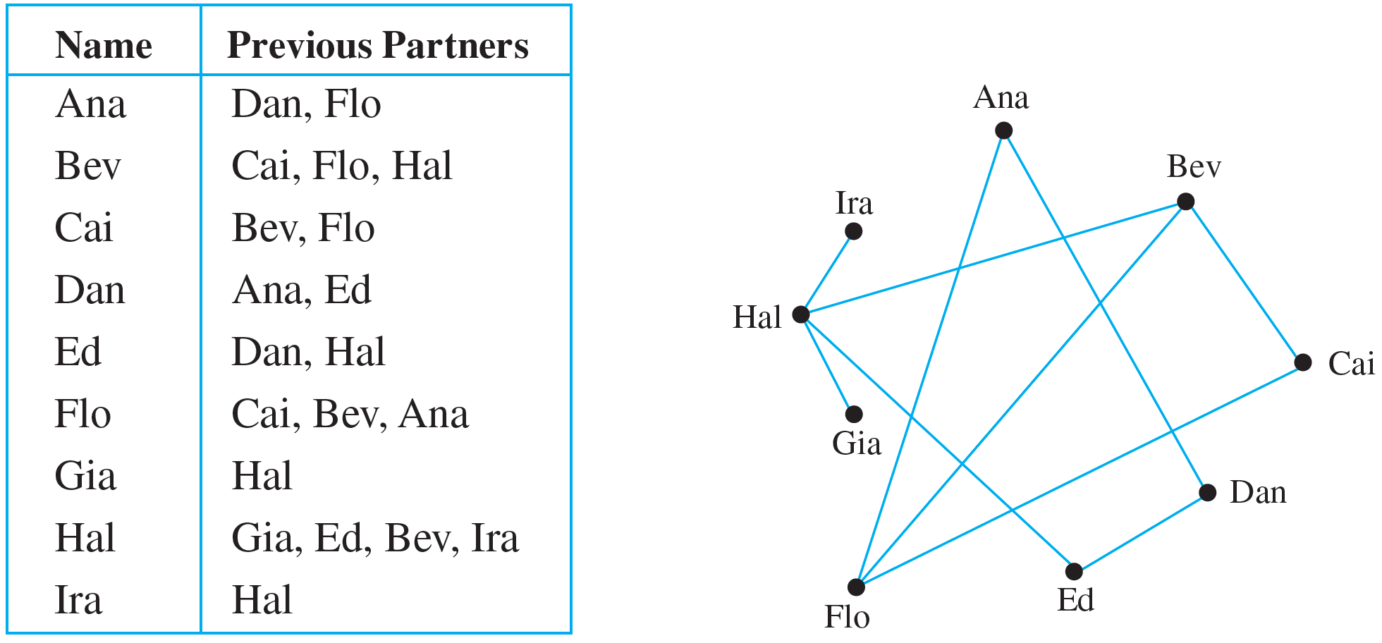
The Language of Graphs
This information is displayed below both in a table and in a diagram.

Slide 5
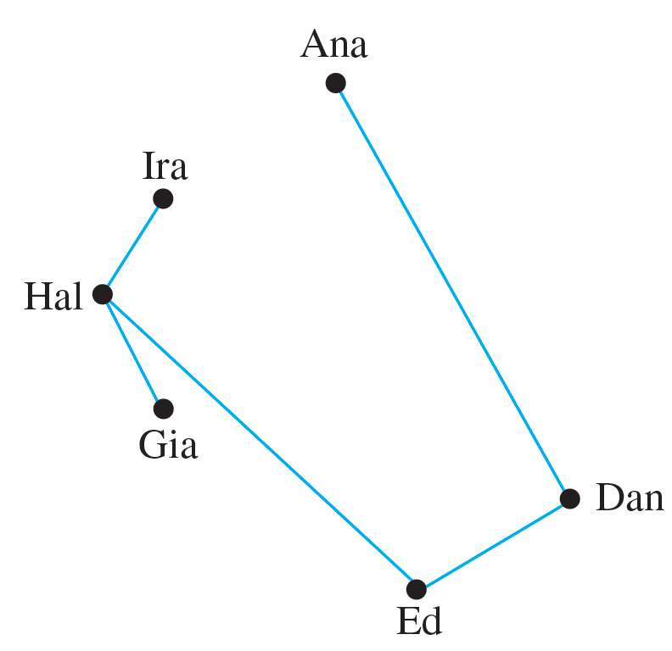
The Language of Graphs
From the diagram, it is easy to see that Bev, Cai, and Flo are a group of three previous partners, and so it would be reasonable for them to form one of these teams. The drawing below shows the result when these three names are removed from the diagram.

Slide 6
The Language of Graphs
This drawing shows that placing Hal on the same team as Ed would leave Gia and Ira on a team where they would not have a previous partner.
However, if Hal is placed on a team with Gia and Ira, then the remaining team would consist of Ana, Dan, and Ed, and everyone on both teams would be working with a previous partner.

Slide 7
The Language of Graphs
Drawings such as these are illustrations of a structure known as a graph. The dots are called vertices (plural of vertex) and the line segments joining vertices are called edges.
As you can see from the first drawing, it is possible for two edges to cross at a point that is not a vertex. Note also that the type of graph described here is quite different from the “graph of an equation” or the “graph of a function.”

Slide 8
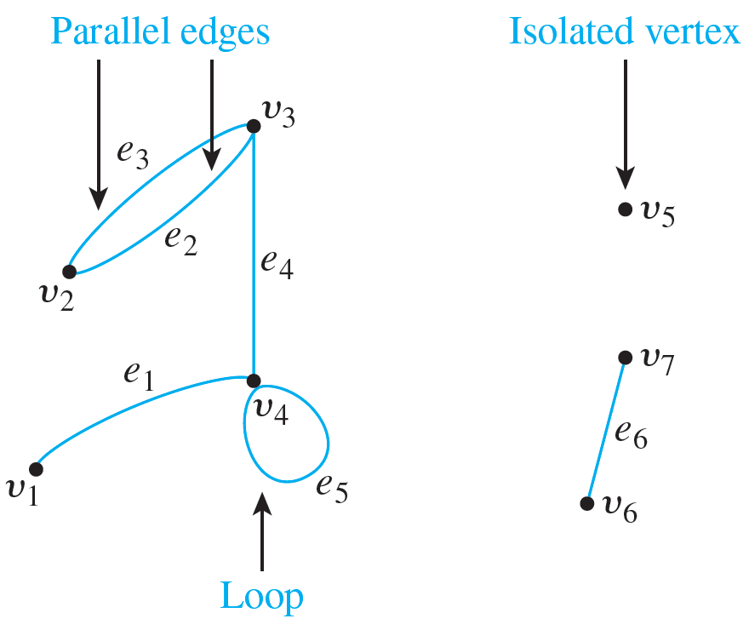
The Language of Graphs
In general, a graph consists of a set of vertices and a set of edges connecting various pairs of vertices. The edges may be straight or curved and should either connect one vertex to another or a vertex to itself, as shown below.

Slide 9
The Language of Graphs
In this drawing, the vertices are labeled with v’s and the edges with e’s. When an edge connects a vertex to itself (as e₅ does), it is called a loop.
When two edges connect the same pair of vertices (as e₂ and e₃ do), they are said to be parallel. It is quite possible for a vertex to be unconnected by an edge to any other vertex in the graph (as v₅ is), and in that case the vertex is said to be isolated.

Slide 10
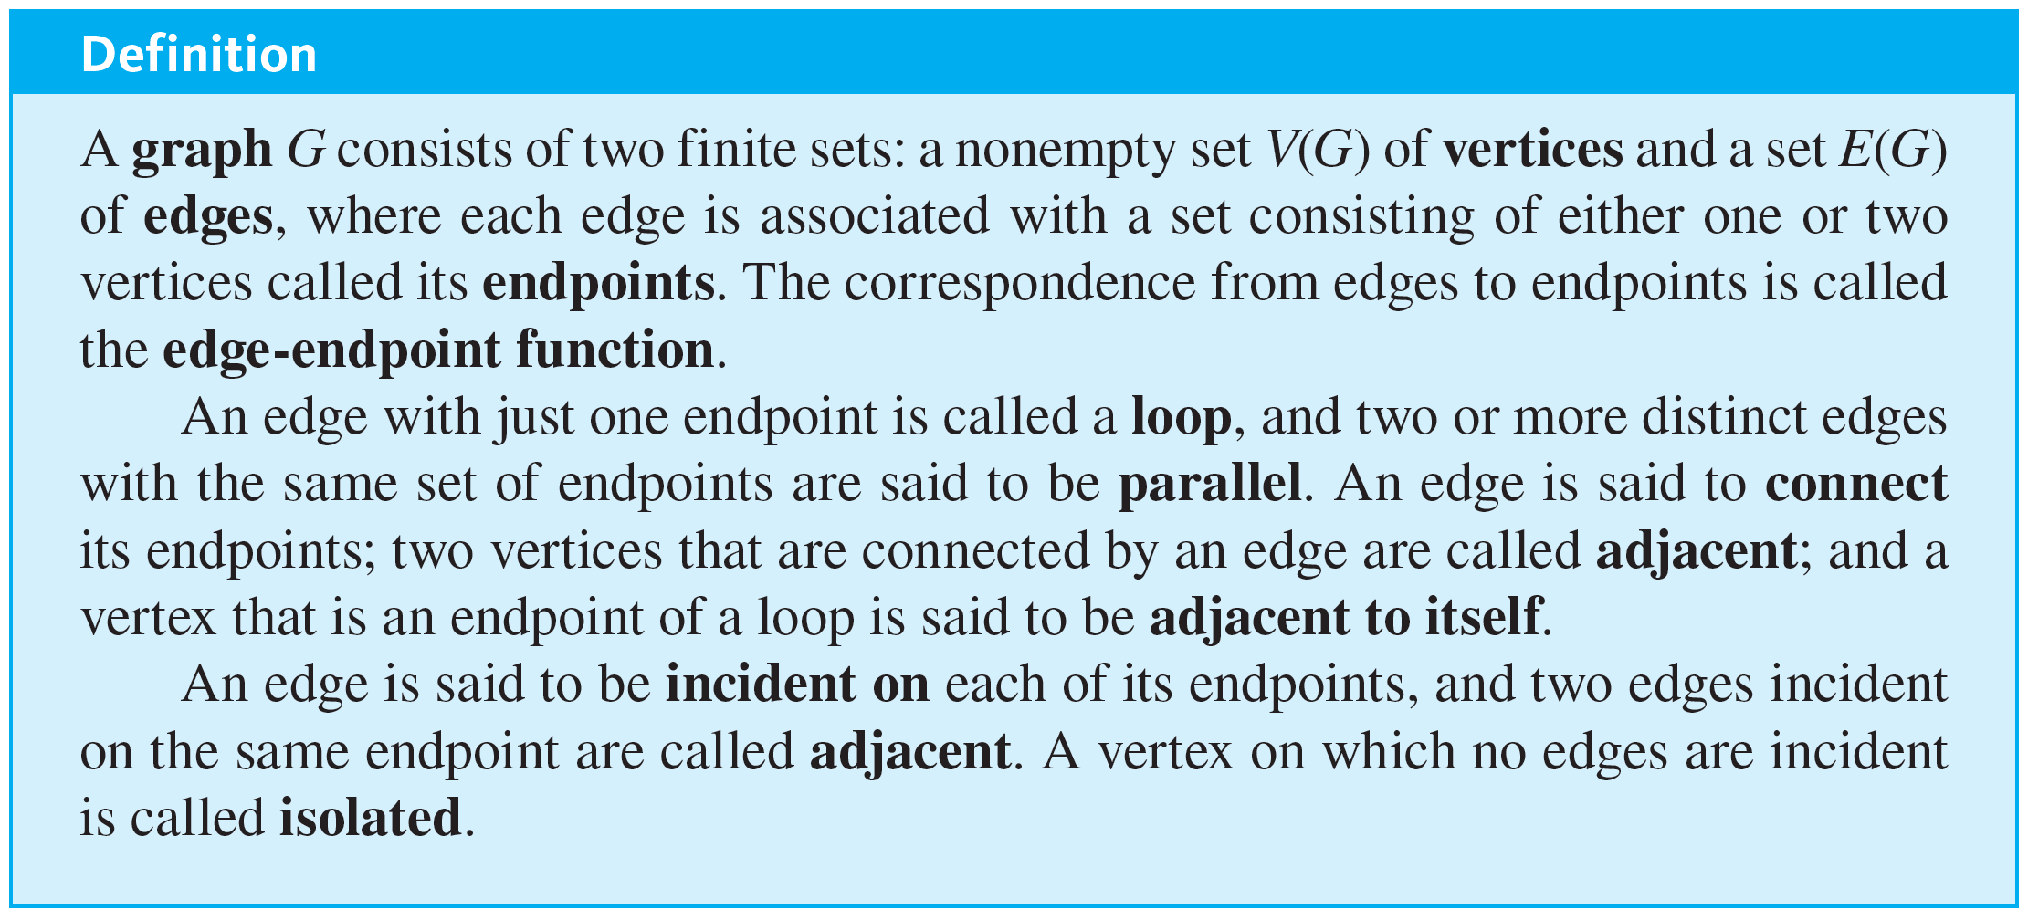
The Language of Graphs
The formal definition of a graph follows.

Slide 11
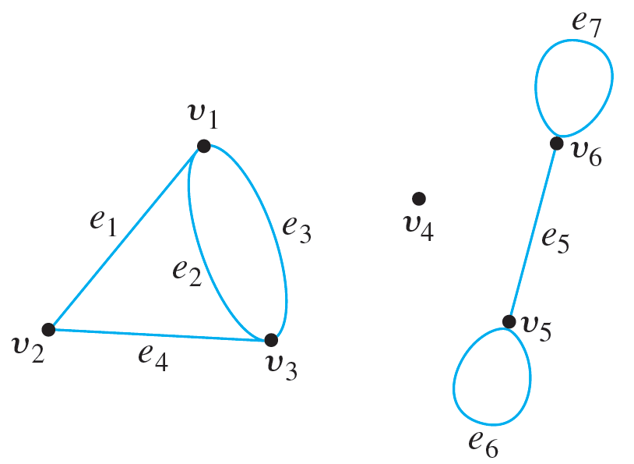
Example 1.4.1 – Terminology
Consider the following graph:
a. Write the vertex set and the edge set, and give a table showing the edge-endpoint function.

Slide 12
Example 1.4.1 – Terminology
continued
b. Find all edges that are incident on v₁, all vertices that are adjacent to ν₁, all edges that are adjacent to e₁, all loops, all parallel edges, all vertices that are adjacent to themselves, and all isolated vertices.

Slide 13
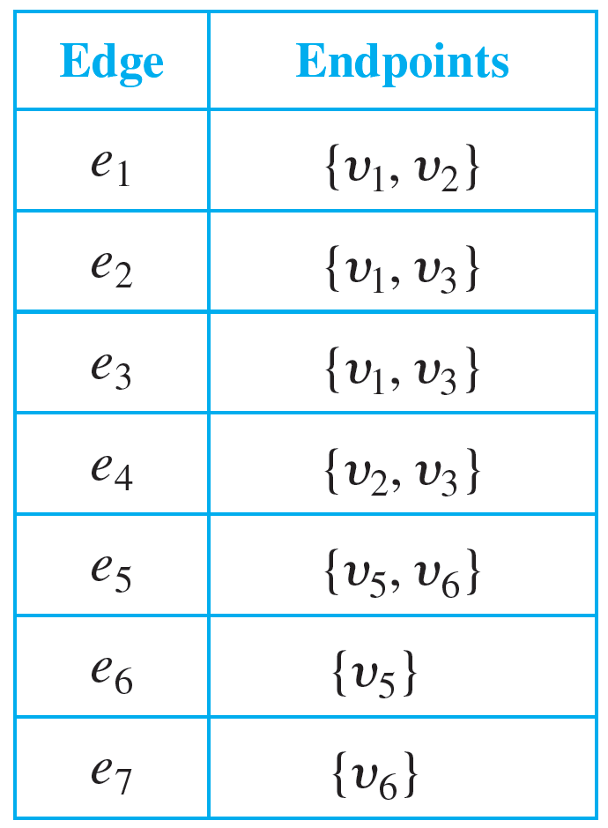
Example 1.4.1 – Solution
a. vertex set = {v₁, v₂, v₃, v₄, v₅, v₆}
edge set = {e₁, e₂, e₃, e₄, e₅, e₆, e₇}
edge-endpoint function:

Slide 14
Example 1.4.1 – Solution
continued
b. e₁, e₂, and e₃ are incident on v₁.
v₂ and v₃ are adjacent to v₁.
e₂, e₃, and e₄ are adjacent to e₁.
e₆ and e₇ are loops.
e₂ and e₃ are parallel.
v₅ and v₆ are adjacent to themselves.
v₄ is an isolated vertex.

Slide 15
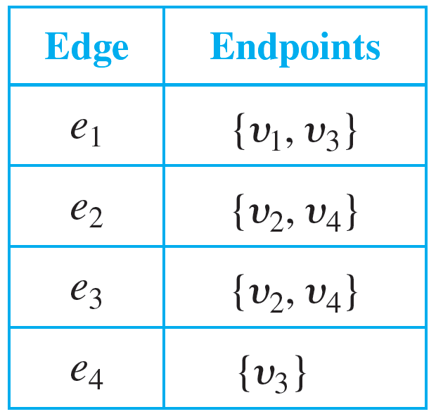
Example 1.4.2 – Drawing More Than One Picture for a Graph
Consider the graph specified as follows:
vertex set = {v₁, v₂, v₃, v₄}
edge set = {e₁, e₂, e₃, e₄}
edge-endpoint function:

Slide 16
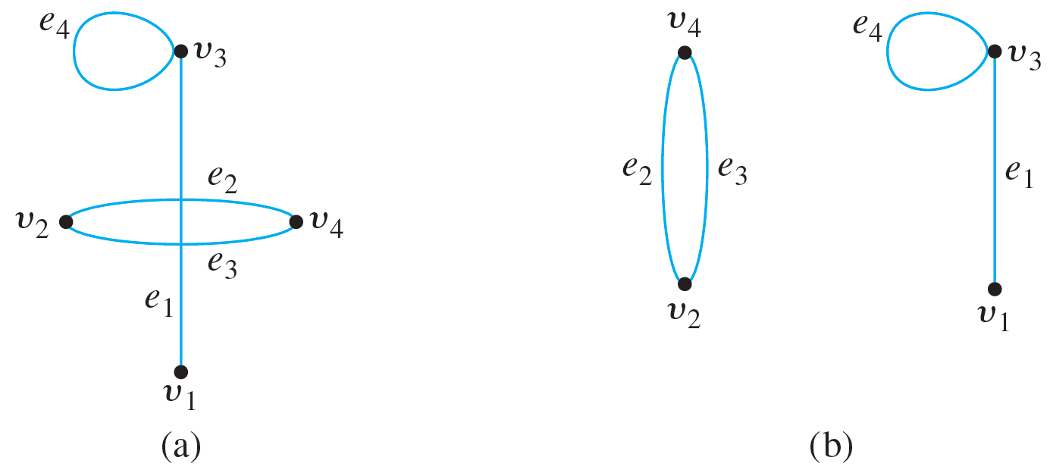
Example 1.4.2 – Drawing More Than One Picture for a Graph
continued
Both drawings (a) and (b) shown below are pictorial representations of this graph.

Slide 17
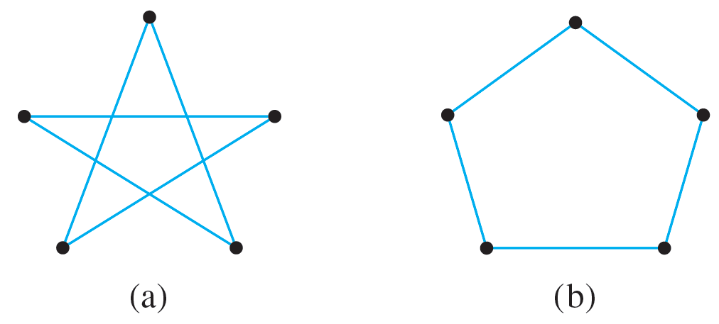
Example 1.4.3 – Labeling Drawings to Show They Represent the Same Graph
Consider the two drawings shown in Figure 1.4.1. Label vertices and edges in such a way that both drawings represent the same graph.
Figure 1.4.1

Slide 18
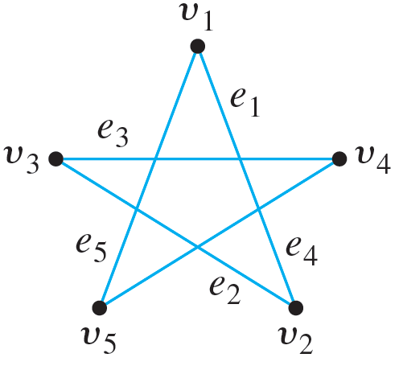
Example 1.4.3 – Solution
Imagine putting one end of a piece of string at the top vertex of Figure 1.4.1(a) (call this vertex v₁), then laying the string to the next adjacent vertex on the lower right (call this vertex v₂), then laying it to the next adjacent vertex on the upper left (v₃), and so forth, returning finally to the top vertex v₁. Call the first edge e₁, the second e₂, and so forth, as shown below.

Slide 19
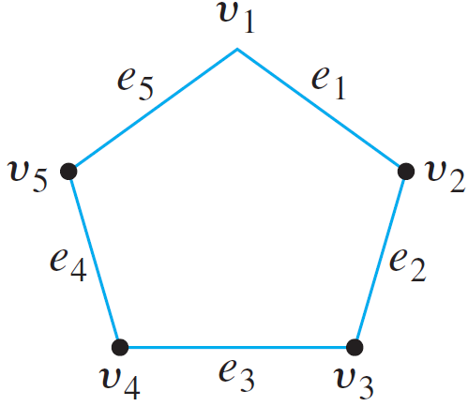
Example 1.4.3 – Solution
continued
Now imagine picking up the piece of string, together with its labels, and repositioning it as follows:

Slide 20
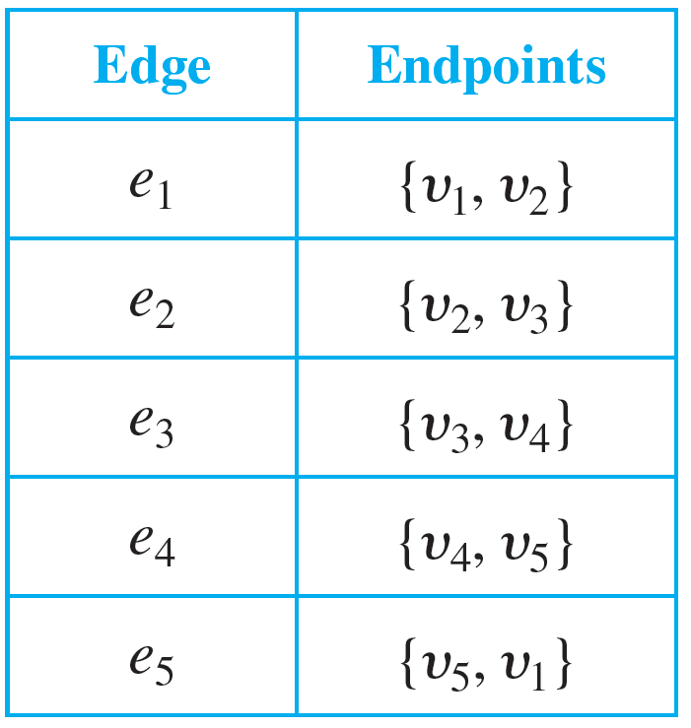
Example 1.4.3 – Solution
continued
This is the same as Figure 1.4.1(b), so both drawings represent the graph with vertex set {v₁, v₂, v₃, v₄, v₅}, edge set {e₁, e₂, e₃, e₄, e₅}, and edge-endpoint function as follows:

Slide 21
Examples of Graphs

Slide 22
Example 1.4.4 – Using a Graph to Represent a Network
Telephone, electric power, gas pipeline, and air transport systems can all be represented by graphs, as can computer networks—from small local area networks to the global Internet system that connects millions of computers worldwide.
Questions that arise in the design of such systems involve choosing connecting edges to minimize cost, optimize a certain type of service, and so forth.

Slide 23
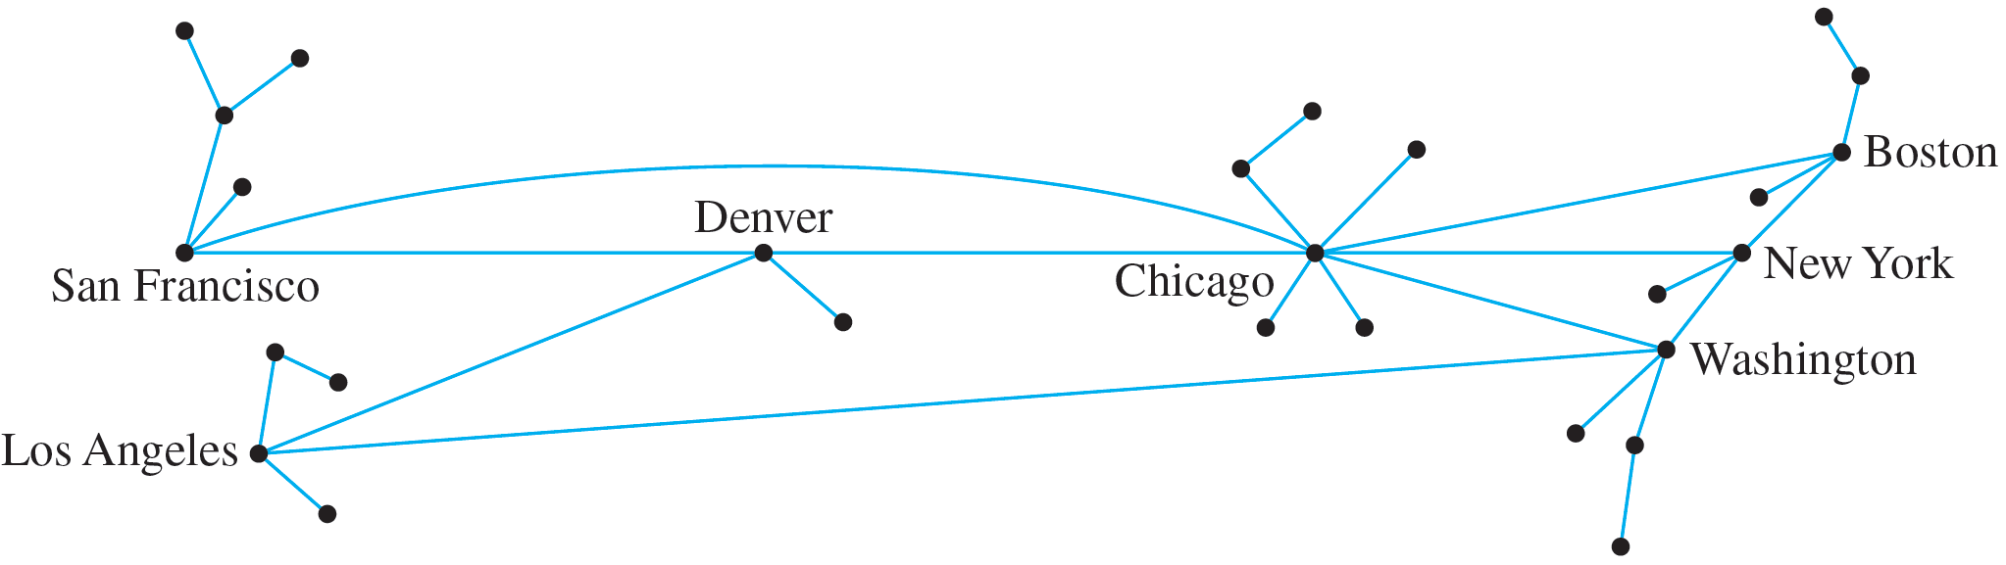
Example 1.4.4 – Using a Graph to Represent a Network
continued
A typical network, called a hub-and-spoke model, is shown below.

Slide 24
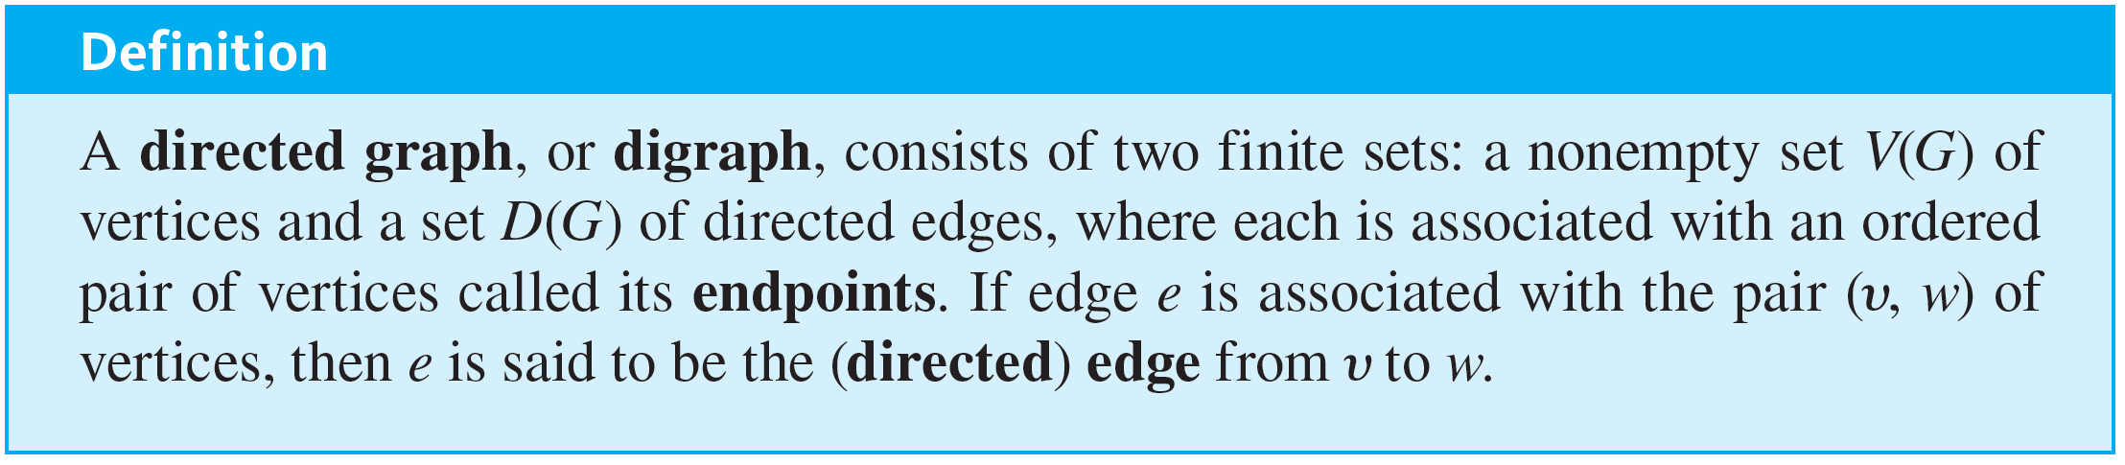
Examples of Graphs
A directed graph is like an (undirected) graph except that each edge is associated with an ordered pair of vertices rather than a set of vertices. Thus each edge of a directed graph can be drawn as an arrow going from the first vertex to the second vertex of the ordered pair.

Slide 25
Example 1.4.6 – Using a Graph to Represent Knowledge
In many applications of artificial intelligence, a knowledge base of information is collected and represented inside a computer. Because of the way the knowledge is represented and because of the properties that govern the artificial intelligence program, the computer is not limited to retrieving data in the same form as it was entered; it can also derive new facts from the knowledge base by using certain built-in rules of inference. For example, from the knowledge that the Los Angeles Times is a big-city daily and that a big-city daily contains national news, an artificial intelligence program could infer that the Los Angeles Times contains national news.

Slide 26
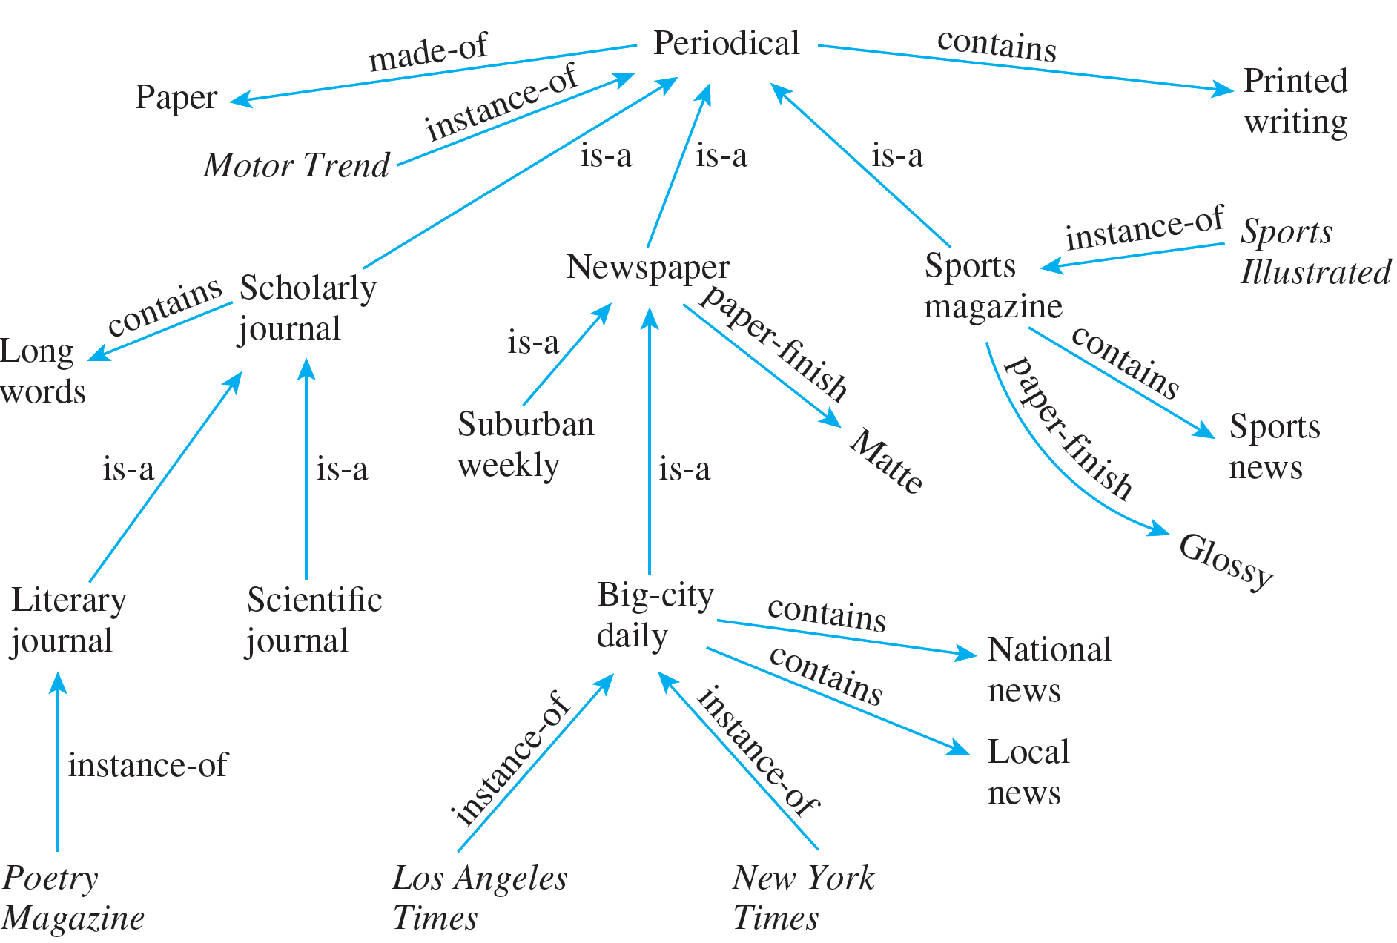
Example 1.4.6 – Using a Graph to Represent Knowledge
continued
The directed graph shown in Figure 1.4.2 is a pictorial representation for a simplified knowledge base about periodical publications.
Figure 1.4.2

Slide 27
Example 1.4.6 – Using a Graph to Represent Knowledge
continued
According to this knowledge base, what paper finish does the New York Times use?

Slide 28
Example 1.4.6 – Solution
The arrow going from New York Times to big-city daily (labeled “instanceof”) shows that the New York Times is a big-city daily. The arrow going from big-city daily to newspaper (labeled “is-a”) shows that a big-city daily is a newspaper.
The arrow going from newspaper to matte (labeled “paper-finish”) indicates that the paper finish on a newspaper is matte. Hence it can be inferred that the paper finish on the New York Times is matte.

Slide 29
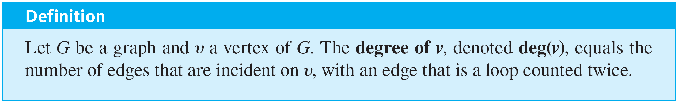
Examples of Graphs

Slide 30
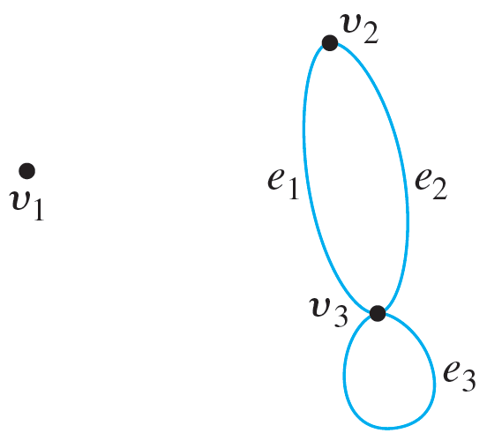
Example 1.4.8 – Degree of a Vertex
Find the degree of each vertex of the graph G shown below.

Slide 31
Example 1.4.8 – Solution
deg(v₁) = 0 since no edge is incident on v₁ (v₁ is isolated).
deg(v₂) = 2 since both e₁ and e₂ are incident on v₂.
deg(v₃) = 4 since e₁ and e₂ are incident on v₃ and the loop e₃ is also incident on v₃ (and contributes 2 to the degree of v₃).

Slide 32
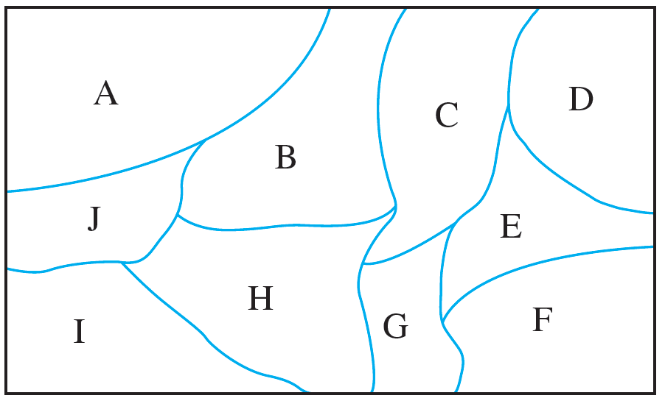
Example 1.4.9 – Using a Graph to Color a Map
Imagine that the diagram shown below is a map with countries labeled A–J. Show that you can color the map so that no two adjacent countries have the same color.

Slide 33
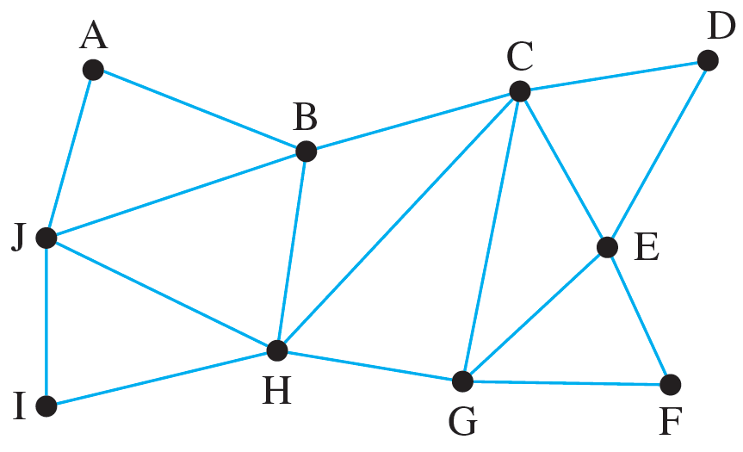
Example 1.4.9 – Solution
Notice that coloring the map does not depend on the sizes or shapes of the countries, but only on which countries are adjacent to which. So, to figure out a coloring, you can draw a graph, as shown below, where vertices represent countries and where edges are drawn between pairs of vertices that represent adjacent countries.

Slide 34
Example 1.4.9 – Solution
continued
Coloring the vertices of the graph will translate to coloring the countries on the map.
As you assign colors to vertices, a relatively efficient strategy is, at each stage, to focus on an uncolored vertex that has maximum degree, in other words that is connected to a maximum number of other uncolored vertices.

Slide 35
Example 1.4.9 – Solution
continued
If there is more than one such vertex, it does not matter which you choose because there are often several acceptable colorings for a given graph.

Slide 36
Example 1.4.9 – Solution
continued
For this graph, both C and H have maximum degree so you can choose one, say, C, and color it, say, blue.
Now since A, F, I, and J are not connected to C, some of them may also be colored blue, and, because J is connected to a maximum number of others, you could start by coloring it blue.

Slide 37
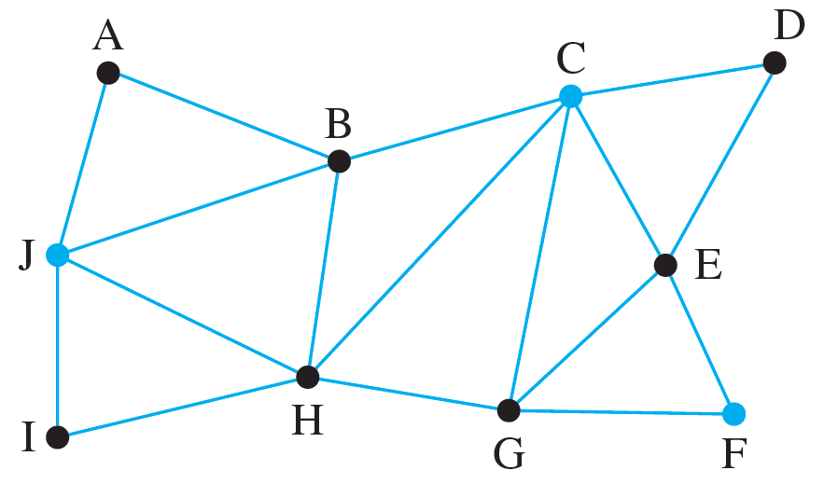
Example 1.4.9 – Solution
continued
Then F is the only remaining vertex not connected to either C or J, so you can also color F blue. The drawing below shows the graph with vertices C, J, and F colored blue.

Slide 38
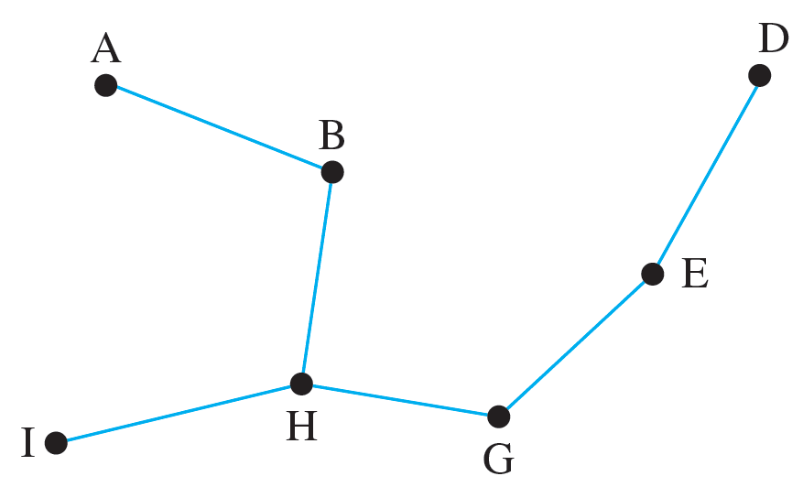
Example 1.4.9 – Solution
continued
Since the vertices adjacent to C, J, and F cannot be colored blue, you can simplify the job of choosing additional colors by removing C, J, and F and the edges connecting them to adjacent vertices. The result is shown in Figure 1.4.4a.
Figure 1.4.4(a)

Slide 39
Example 1.4.9 – Solution
continued
In the simplified graph again choose a vertex that has a maximum degree, namely H, and give it a second color, say, gray.
Since A, D, and E are not connected to H, some of them may also be colored gray, and, because E is connected to a maximum number of these vertices, you could start by coloring E gray.

Slide 40
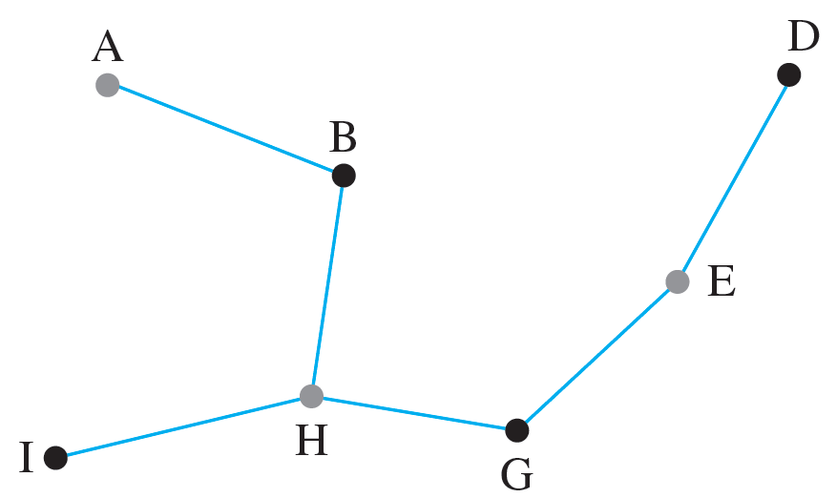
Example 1.4.9 – Solution
continued
Then A is not connected to E, and so you can also color A gray. This is shown in Figure 1.4.4b.
Figure 1.4.4(b)

Slide 41
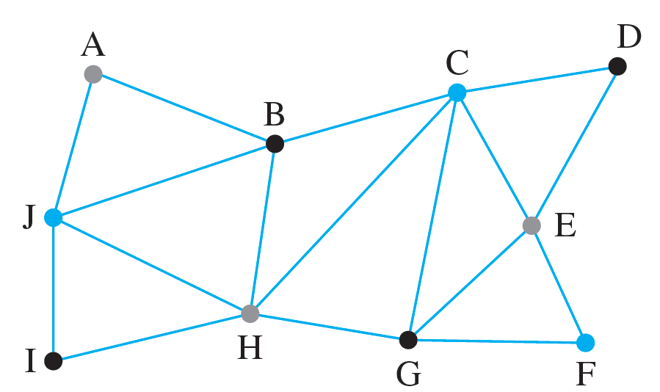
Example 1.4.9 – Solution
continued
The drawing below shows the original graph with vertices C, J, and F colored blue, vertices H, A, and E, colored gray, and the remaining vertices colored black. You can check that no two adjacent vertices have the same color.

Slide 42
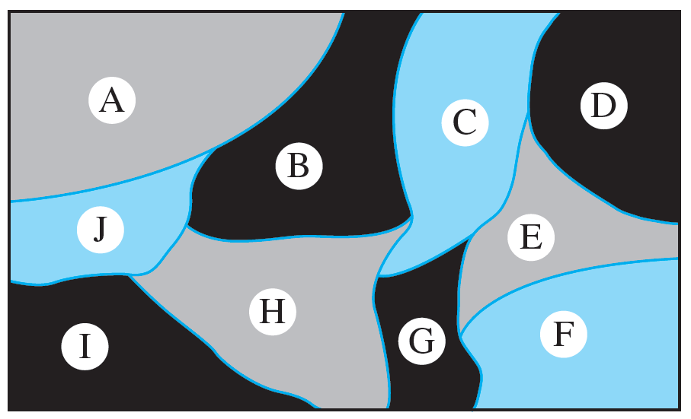
Example 1.4.9 – Solution
continued
Translating the graph coloring back to the original map gives the following picture in which no two adjacent countries have the same color.

